Slide 1
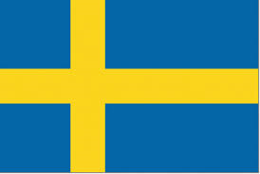
Famous Swedish Persons
Made by Lana Valente-Gomez and Robin de Brabander

Slide 2
Carl Gustav XV1
The king of Sweden since 1973.

Slide 3
ABBA
Pop band and winner of the European Songcontest in 1974.

Slide 4
AVICii
DJ who you may know from songs as: ‘Hey brother’ and ‘Waker me up’.
Avicii died in april 2018

Slide 5
Stieg LArsson
Writer of detective novels.

Slide 6
Pippi Langstrump
The main character in the books of Astrid Lindgren.
Later on they made films and a television series of it.

Slide 7
Björn Borg
A tennis player, who started the brand Björn Borg.

Slide 8
Zlatan Ibrahimovic
A footfall player that played for Ajax, Juventus, Barcelona, Paris Saint Germain and LA Galaxy.

Slide 9
Ingvar kamprad
The founder of IKEA

