Slide 1
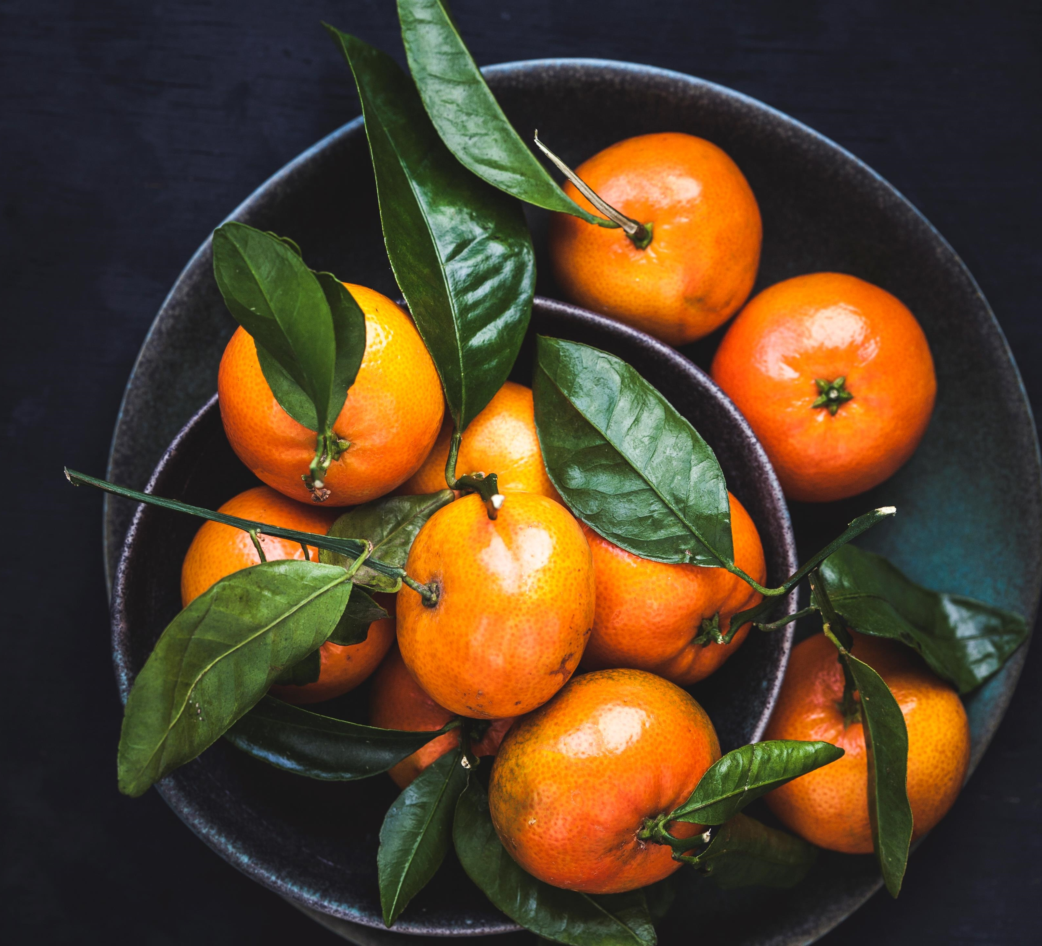
Swedish cuisine
“Learning from the Past to Face the Future: Cultural Heritage in Contrast with Modern Society”
(2018-1-PL01-KA229-051241_1 )
Latvian team

Slide 2
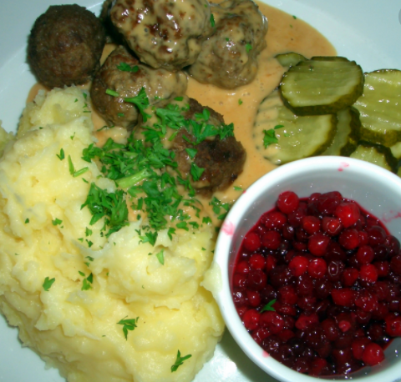
SWEDISH cuisine
The Swedish cuisine shares a lot of similarities with Norwegian cuisine, Danish cuisine, and Finnish cuisine. This is due to the countries’ shared history, dating back to the Vikings.
Meatballs and Pyttipanna are very common to eat within families as it is quick to make and the kids love it. The rest of the dishes are mostly eaten occasionally for festive days or at least not as frequently anymore, but they are still well-known and traditional.

Slide 3
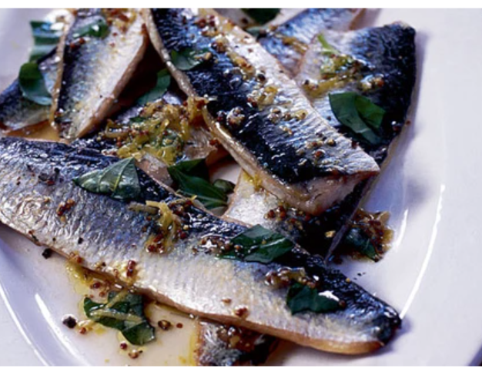
Herring
The Baltic Sea and North Atlantic Ocean are awash with shoals of herring, and Swedes are pros at cooking, pickling and smoking these small, flavoursome fish. There are two names for the fish in Swedish: sill, for the slightly larger fish found off the west coast, and strömming, for Baltic herring. Smör, Ost och Sill (‘butter, cheese and herring’) is best served with crisp bread and washed down with a glass of aquavit, a traditional Scandinavian spirit.

Slide 4
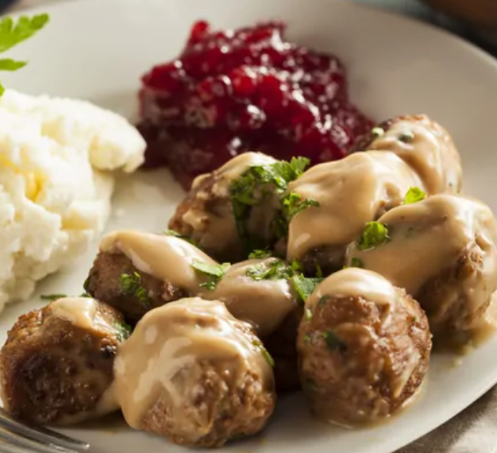
Köttbullar (Meatballs)
Swedish meatballs might be the most iconic dish from Sweden, thanks to IKEA who has put Sweden on the World Map. There are actually several ways you can serve meatballs, but the most common is with mashed potatoes, creme sauce, and lingon.
Meatballs and macaroni with ketchup are especially popular among kids.

Slide 5
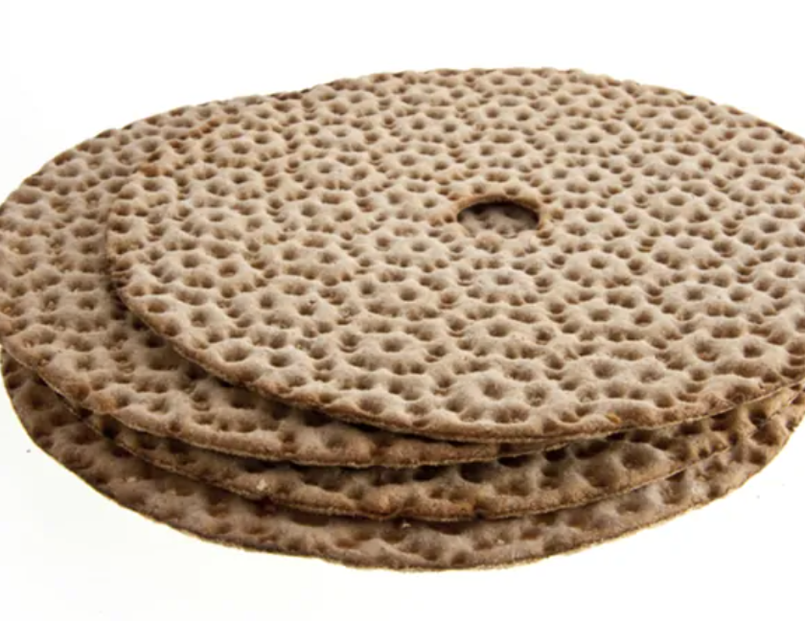
Knäckebröd (Crispbread)
Hard bread might seem strange, but they keep for a long time which is very convenient. It’s a staple food and you will find crispbread in many Swedish homes.
It’s very traditional and the earliest known source for making crispbread dates back to 500 AD.

Slide 6
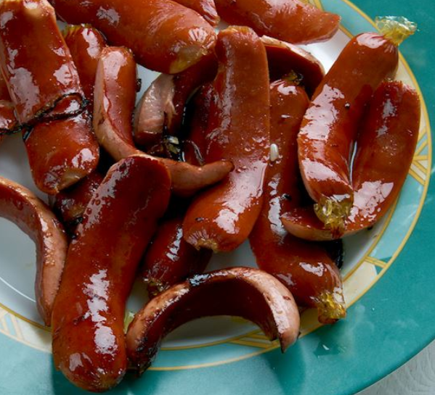
Prinskorv
This Swedish sausage was invented in 1805 by a Viennese butcher, Georg Lahner. Prinskorv is made with spiced pork and veal and it is mainly enjoyed as a snack, fried and served with mustard on the side. It is also a popular element of julbord, the traditional Swedish Christmas buffet-style table.
In southern Sweden, during the midsummer party, it is enjoyed alongside Janssons frestelse, a Swedish casserole consisting of potatoes, onions, pickled sprats, and cream. Prinskorv, literally translated as prince sausage, got its name after specific cuts at each end, which resemble small crowns.

Slide 7
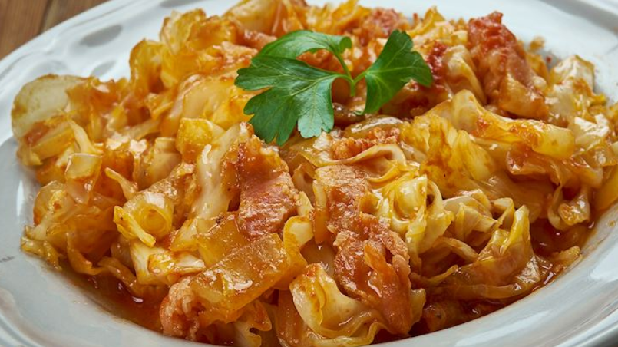
Brunkal
Translated as brown cabbage, this simple Swedish dish consists of white cabbage that is slowly braised with soy sauce, vinegar, and syrup. Usually associated with the Skåne region, the dish is traditionally enjoyed for Christmas, and it is typically served along pork, sausages, or Christmas ham (julskinka).
During cooking, the cabbage turns brown, hence the name.

Slide 8
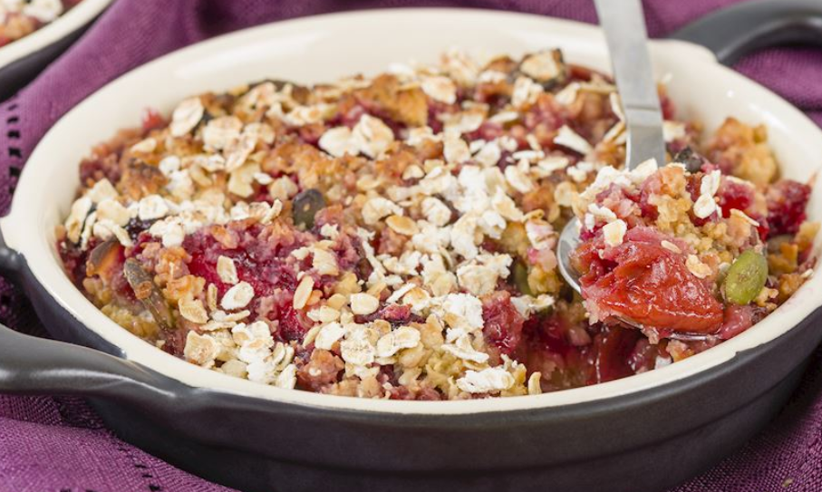
Smulpaj
Smulpaj, from the Swedish words smula, meaning crumb, and paj, meaning pie, is a delicious Swedish crumb pie. It consists of a crumbly mixture poured evenly over diced fruits and berries (typically blueberries and raspberries).
It is flavored with sugar and cinnamon, then baked until crisp. This scrumptious Swedish treat is usually topped with whipped cream, vanilla custard, or ice cream. A crisp and crunchy crumb united with an irresistibly sweet and moist filling make smulpaj a popular treat served in many cafés throughout Sweden.

Slide 9
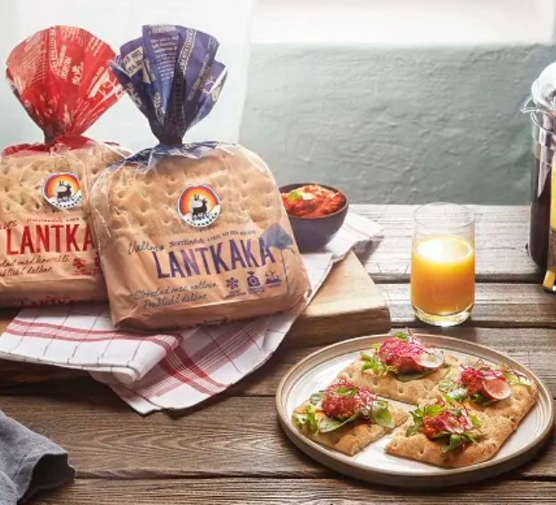
What do Swedes eat for breakfast?
Well, every person usually has their own preference, but some of the most common things you will find in a Swedish breakfast includes:
Various cold cuts, known as “pålägg”
Filmjölk (fermented milk)
Yogurt and various cereals
Bread and buns – Swedes love their sandwiches
Leverpastej & Smörgåsgurka (Liver paste and pickles)
Boiled egg
Caviar

Slide 10
Resources
https://www.google.com/search?q=swedish+cuisine&sxsrf=ALeKk00TUV9fhaljCE4HbCTsd2aJIjrgQg:1601475192161&tbm=isch&source=iu&ictx=1&fir=TwPrD88Thf_v4M%252Cb9PRIur3SQscDM%252C%252Fm%252F071pt&vet=1&usg=AI4_-kQB6eJK_SUYkDt_zuOjjQjEMGRbuQ&sa=X&ved=2ahUKEwjJ1cf_h5HsAhXDwosKHU1lCNsQ_B16BAgXEAM#imgrc=TwPrD88Thf_v4M
https://www.bbcgoodfood.com/howto/guide/top-10-foods-try-sweden
https://hejsweden.com/en/typical-swedish-food/
https://www.tasteatlas.com/50-most-popular-foods-in-sweden
https://www.swedishnomad.com/traditional-swedish-food/

